Slide 1


Capstone Project
AI
Capstone Project
Hotel Booking EDA Analysis
Individual Project
Aneeta
kajalgupta94160@gmail.com

Slide 2
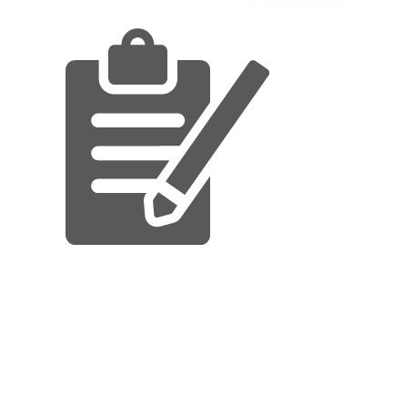
.Problem statement
.Why hotel booking analysis and it’s data
.Data Summary
.Exploring our database
.Flow chart and EDA Process
.Cleaning of Data
.Data Manipulations
.Data Visualization
.Conclusions of our analysis
content

Slide 3
Structure of a Problem Statement
Hotel booking
dataset
.Our agenda is to Analysis of various datasets that covariates governing the bookings of hotels.
.We need to analize the data and come up with meaningful insights that would actually help business to strategize their moves.
.Our main objective is to perform EDA on the given dataset to discover key factor responsible for hotel booking system and their success.
.We need to analyze the data and come up with meaningful insights that would actually help business to strategize their moves.
Data
summary
Cleaning
of Dataset
Analysis &
Visulization

Slide 4
Hotel Booking Analysis and it’s Data ?
.The purpose of our project was to gather and analyze detailed information and hostels
in order to provide insights and estimate the profit.
. The majority of Revenue Management research on demand forecasting and prediction issues is
Conducted in the tourism and travel-related industries
.We have given two hotel data sets .i.e., the resort hotel is one of the hotels , and the city hotel is the other .There are 32 columns and 119390 rows.
.Hotel will be able to identify the issues that is causing customers to cancel their bookings , as well as the cancellation , by utilizing the predictive .
. It would be fantastic if the hotel management team could identify the root cause and develop a better strategy.
.The goal of our project was to collect and analyze detailed hotel information in order to provide insights and estimate profit.

Slide 5
Data Summary
.Analysis of the dataset over a span of Three years – 2015 , 2016 and2017
.hotel
. is_canceled
.lead_time
.arrival_date_year
.arrival_date_month
.arrival_date_week_number
.arrival_date_day_of_month
stays_in_weekend_nights
.stays_in_weekend_nights
.stays_in_week_nights
Adults
.children
.babies
.meal
.country
.market_segment
Distribution_channel
.is_repeated_guest
.previous_cancellations
.previous_bookings_not_canceled
.reserved_room_type
.assigned_room_type
.booking_changes
.deposit_type
.agent
.company
.days_in_waiting_list
.customer_type
.Adr
.required_car_parking_spaces
.total_of_special_requests
.reservation_status
.reservation_status_date

Slide 6
Exploring our Database
. In Hotel booking it contain basics information about two types of hotel city hotel and resort
‘We have given 32 rows and 119390 columns . The feature of play store are:-
. Hotel : Hotel type.
. Is_canceled : value indicates if the booking is canceled or not.
. Lead_time : How long in advance the booking was made.
. Arrival_date_year : Customer arrival year.
. Arrival_date_month : in which week of the year customer visited hotel.

Slide 7
Continue..
.arrival_date_month : in which month of the year customer visisted hotel.
.arrival_date_week_number : in which week of the year customer arrived.
.arrival_date_day_of_month : date of the month customer visited hotel.
.stays_in_weekend_nights : customer stayed or booked to stay in hotel during weekend nights.
.stays_in_week_nights : customer stayed in hotel during week nights.
.adults : number of adults.
.children : number of children

Slide 8
Flowchart and EDA process
Data Analysis
Data Prepartion
Communicate
visualise
Import
Analyze
Reports
Ask/answer
question
Answer
manipulate

Slide 9
Cleaning of Data and Manpulation
Company and agent values
replaced with zero
Converting datatype of columns
Children company and
Agent from float to int
Dropped duplicate
rows from the dataset
Changing datatype of column
reservation_status_date
to date_type

Slide 10
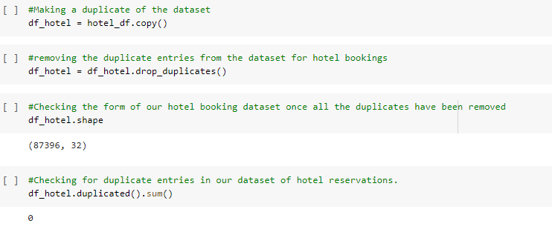
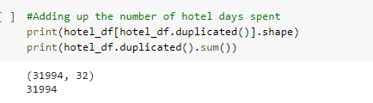
Removing Duplicates

Slide 11
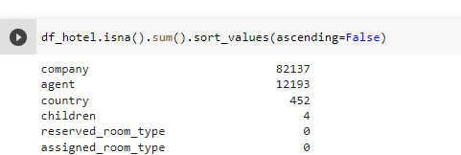
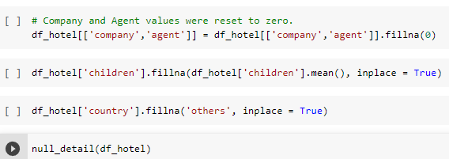
Dealing with null values of play store
There are 4 columns children , agent,company,country with null values

Slide 12
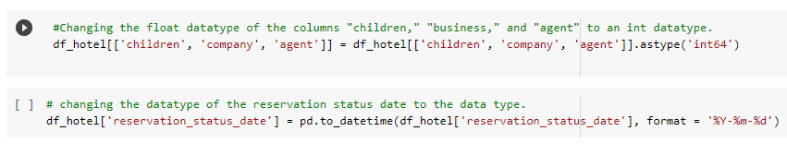
Converting Datatypes

Slide 13
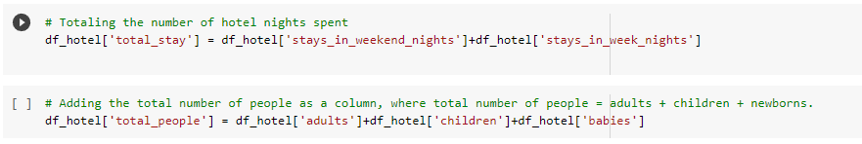
Adding Required Columns

Slide 14

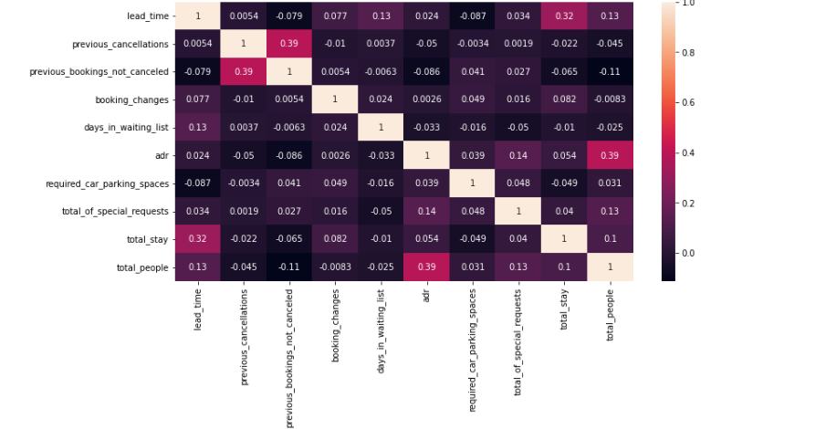
Data Visualization
There is a week association between the total length of stay and the lead time.
This could mean that people don’t typically
Make deleated plans for extend hotel
stays

Slide 15
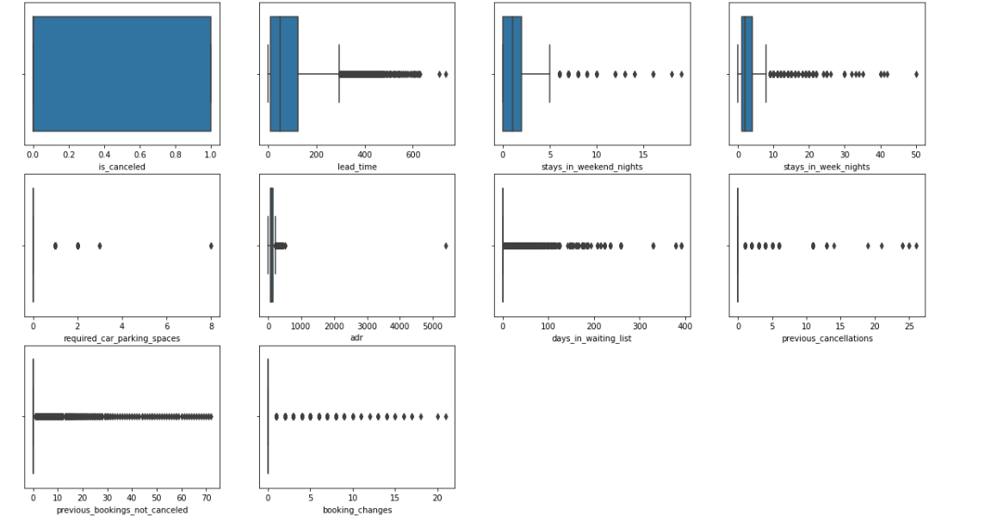
Datavisualization
AS We can observe that this Dataset has a lot of outliner, which suggest
That it is not particularly depend.

Slide 16
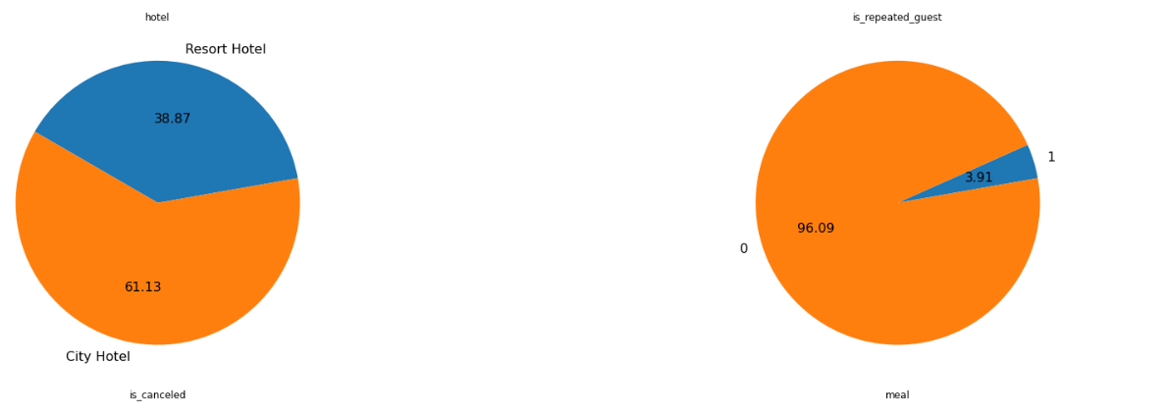
Data Visualization
Which type of hotel is monthly preferred by the customer ? No of repeated guest
Resorts hotels were the preferred choice Between city and resorts by the customer With 61.13% booking could be attribute
Facility.
New guest are more as 3.91% guests were Repeated.

Slide 17
Datavisualization
1. How many of each sort of hotel are there?
[ ]
2. Which of the two hotels consumers prefer, and which month had the most hotel reservations?
3. Which hotel will have long term visitors?
4. What kind of meals does the visitor prefer??
5. Which country has the most amount of visitors?
[ ]
# keep track of the hostels that were not cancelled.
bookedHotel_not_canceled = df_hotel[df_hotel['is_canceled'] == 0]
6. which hotel generates the most revenue?
7. which kind of accommodation has the highest daily average cost?
8. Are reservations canceled as a result of a long waiting period?
9. What is the percentage distribution of required_car_parking_spaces?
10. What month has the highest ADR for hotels?

Slide 18
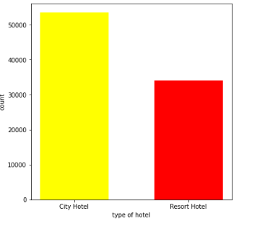
Data Visualization
What is the count of each type of Hotel ?
.From the above, we learned
that people are
Booking city hotels more than
resort hotel out
In which month the
people book the hotel

Slide 19
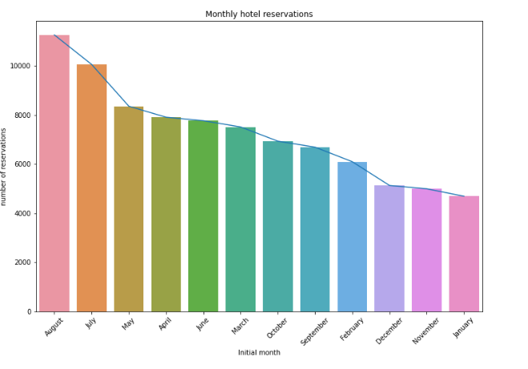
Data Visualization
Which of the two hotels is preferred by customers , and in which month had the most
Hotel reservation ?

Slide 20
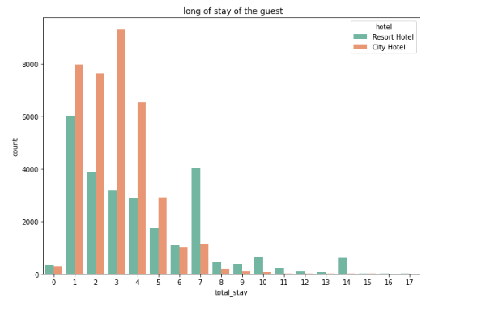
Data visualization
Which hotel will have long term visitor ?
While most city hotel guests between
One and seven days, three, most resort
Hotel customer typically stay.

Slide 21
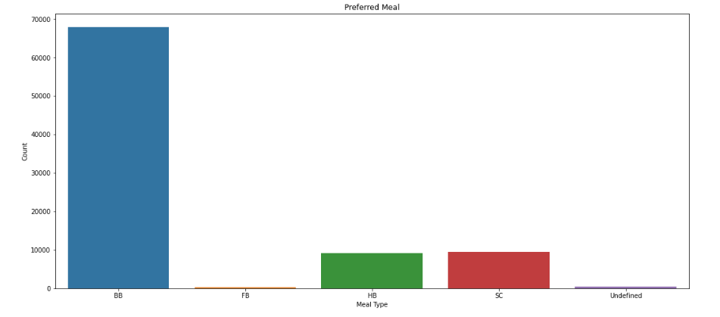
Datavisualization
What kind of meals does the prefer visitor?
Meal type hotel
HB: (half board)
BB : ( Bed& Breakfast)
SC : ( Supplemental&Committee)
FB : ( full board self catering)
As a result ,the most powerful
Meal type among guests is BB
( Bed & breakfast) followed by HB
(Half board & self caring ).

Slide 22
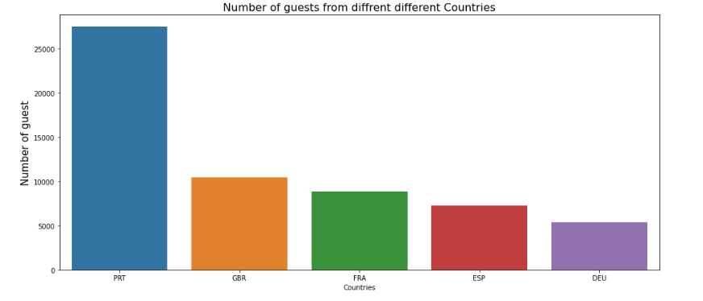
Data visualization
Which country has the most amount of visitors?
More than 2500 people or the
Majority of the attendance
Are from Portugal
PRT- Portugal
GBR – United Kingdom
FRA – France
ESP – Spain
DEU - Germany

Slide 23
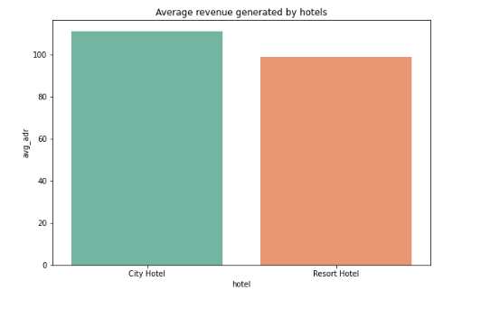
Datavisulaization
Which hotel generates the most revenue ?
The graph show that
city hotel generate
An average revenue
that is higherThan
that of resort hotel.

Slide 24
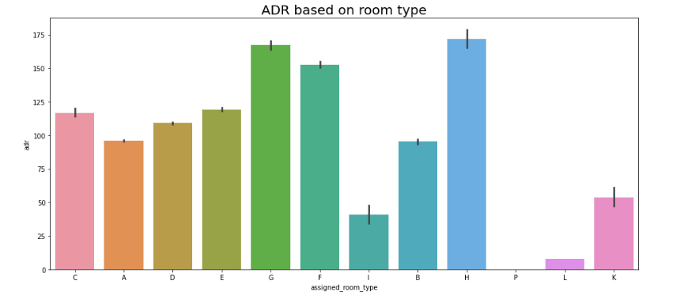
Data visualization
Which kind of accommodationHas the highest daily average cost ?
H type, followed by
G type,has the highest
Average daily rate.

Slide 25
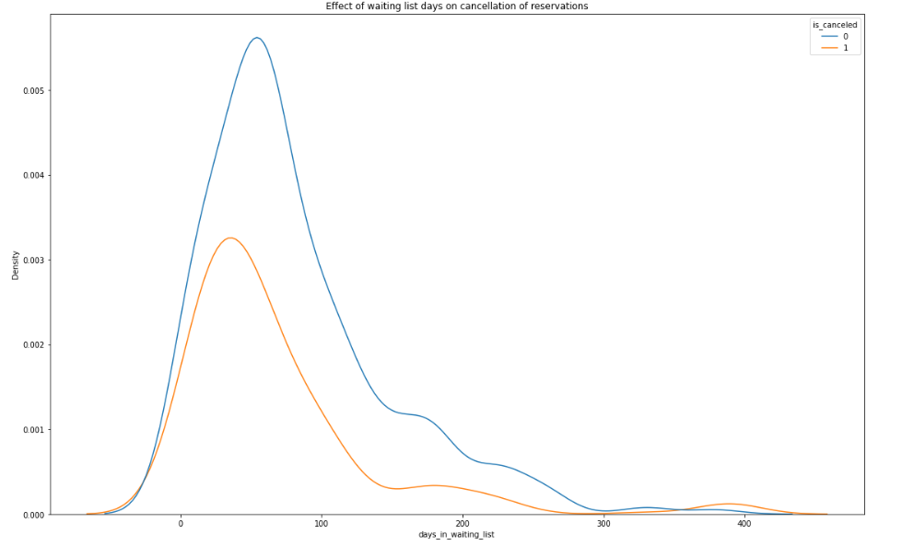
Data visualization
Are reservation canceled as a Result of a long waiting period ?
As u can see from the fact that
The majority of booking with
Less than 100 days on the waiting
List were canceled , there is no direct
Link between longer period and a cncellation Of a reservation.

Slide 26
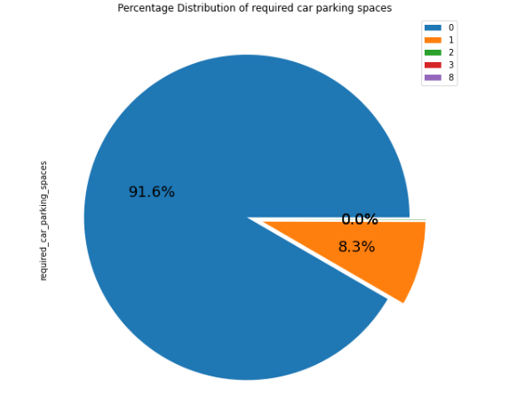
Data visualization
What is the percentage of Distribution of required_car_parking_space?
91.6 % of vistiors don’t need a parking spot
Only 8.3% of visitors needed a parking slot.

Slide 27
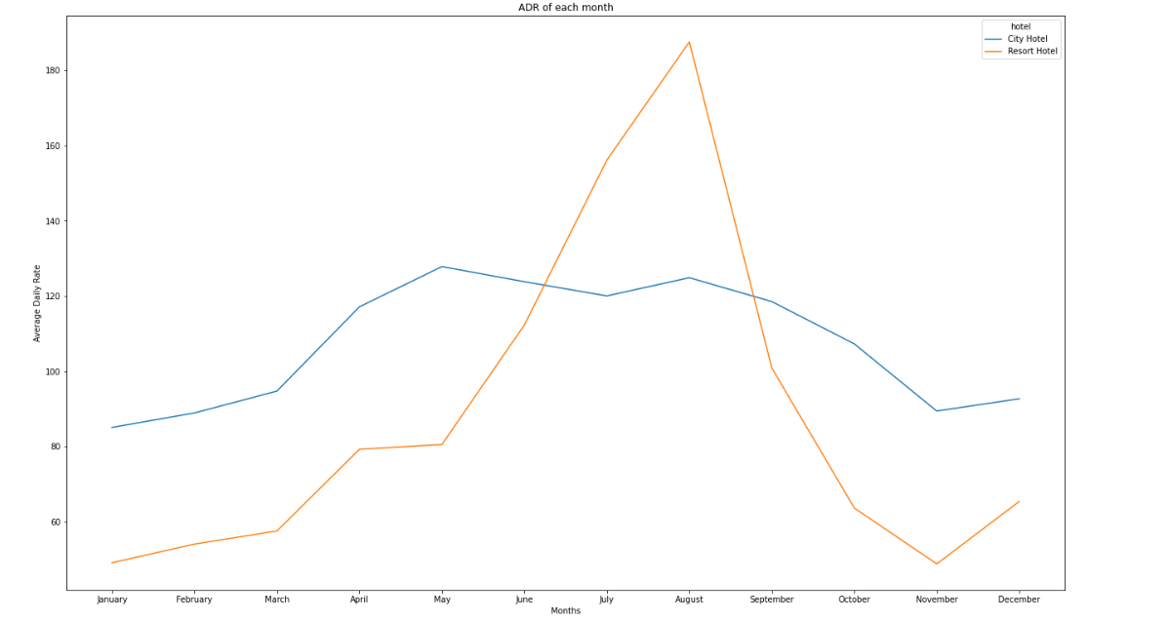
Data visualization
What month has the highest ADR for hotels ?
The ADR for resort hotel
Is greater in the months
Of June, July and august when compare
To city hotels. This summer
Guest,client want to stay at resort hotel.
Due to the low average daily rate during
These months, Jan , Feb, March , April, October,November , December
Are the best months for travellers to resort or city hotels.

Slide 28
Conclusion…
Due to this, we discovered that city hotels were in high demand, with reservations peaking in August. As a result, we were able to plan ahead for August and set up certain offers and discounts to increase earnings.
While most city hotel guests spend between one and seven days there, most resort hotel customers typically stay for one day.
Meal types in hotels: HB- (Half Board) (Half Board) BB - (Bed and Breakfast) SC- (Supplemental Committee) FB- (Full Board) (Self Catering)
As a result, the most popular meal type among guests is BB (Bed and Breakfast), followed by HB (Half Board) and SC (Self Catering).
Obseravtion : More than 25000 people, or the majority of the attendees, are from Portugal.Abbreviations for nations:
PRT- Portugal GBR- United Kingdom FRA- France ESP- Spain DEU - Germany
The aforementioned graph shows that city hotels generate an average revenue that is higher than that of resort hotels.

Slide 29
Conitnue…
H type, followed by G type, has the highest average daily rate
As can be seen from the fact that the majority of bookings with less than 100 days on the waiting list were cancelled, there is no direct link between a longer waiting period and a cancellation of a reservation. However, a somewhat larger percentage of reservations were also cancelled when they were more than 100 days on the waiting list.
91.6% of visitors don't need a parking spot. Only 8.3% of visitors needed a parking spot.
The ADR for Resrot Hotel is greater in the months of June, July, and August when compared to City Hotels. This summer, guests/clients could want to stay at resort hotels.

Slide 30


